Slide 1
Lecture 8 Binary Search Tree and Trie Exercises ANS
Department of Computer Science
Hofstra University

Slide 2
Binary Tree
For a binary tree of height h, what is its minimum and maximum number of leaves and total nodes?
When it is a full binary tree, it has
Max number of leaves: 2^{h}
Max number of nodes: 2^{(h + 1)} - 1
When it is a linked list:
Min number of leaves: 1
Min number of nodes: h + 1
1
1
0
4
4
-2
0.5
2
8
8
h=2
h=2

Slide 3
Balanced BST
Which is a Balanced BST?
ANS: c. Only it satisfies the property:
| LeftHeight – RightHeight | <=1
eat
east
east
ate
at
eat
ear
ate
at
east
am
ate
at
am
ear
eat
ear
am
(a)
(b)
(c)

Slide 4
Binary Search Tree (BST)
Which of the following is a BST?
ANS: A
C
✗
D
✗
A
B
✗
42
42
42
42
32
12
32
65
32
65
12
32
12
✓
30
38
12
45
32 < 42
Not a binary tree
45 > 42
Notes:
Each node can have 2 subtrees.
Items to the left of a given node are smaller.
Items to the right of a given node are larger.

Slide 5
Pre, In and Post Order Traversal
1
Pre-Order: 12453
In-Order: 42513
Post-Order: 45231
2
3
4
5
1
Pre-Order: 1234
In-Order: 2143
Post-Order: 2431
2
3
4

Slide 6
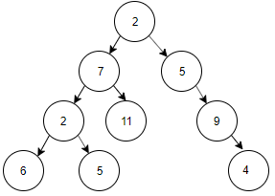
Pre, In and Post Order Traversal
Pre-Order: 2, 7, 2, 6, 5, 11, 5, 9, 4
In-Order: 6, 2, 5, 7, 11, 2, 5, 9, 4
Post-Order: 6, 5, 2, 11, 7, 4, 9, 5, 2

Slide 7
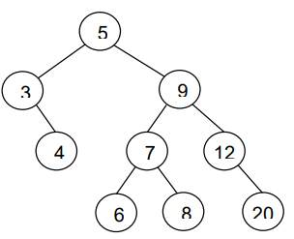
Pre, In and Post Order Traversal
Preorder [5, 3, 4, 9, 7, 6, 8, 12, 20]
In-order: [3, 4, 5, 6, 7, 8, 9, 12, 20]
Post-order: [4, 3, 6, 8, 7, 20, 12, 9, 5]

Slide 8
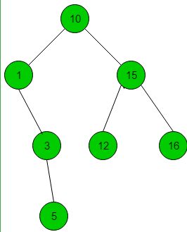
BST
The following numbers are inserted into an empty binary search tree in the given order: 10, 1, 3, 5, 15, 12, 16. What is the height of the binary search tree (the height is the maximum distance of a leaf node from the root, i.e. a tree with a single root node has height 0.)?
ANS: 3

Slide 9
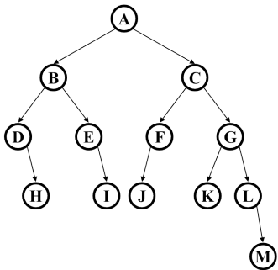
BST
Assume this tree is a binary search tree. What is the maximum number of nodes that could be added to the tree without increasing its height?
ANS: 18
A full binary tree with height h has a total number of nodes given by the formula: n = 2^{h+1}−1 = 2⁴⁺¹−1=31, since the height is 4.
Currently there are 13 nodes, so you can add 31-13=18 nodes without increasing its height.
You can also count the inserted nodes until the tree is full.

Slide 10
BST
Suppose the numbers 7, 5, 1, 8, 3, 6, 0, 9, 4, 2 are inserted in that order into an initially empty binary search tree. What is the in-order traversal sequence of the resultant tree?
ANS: 0 1 2 3 4 5 6 7 8 9
In-order traversal of a binary search tree visits the nodes in ascending order of their values. You do not need to construct the tree.

Slide 11
Quiz: Tree Derivation
Given: Pre-order traversal of nodes is 1, 2, 4, 5, 3, 6; In-order traversal of nodes is 4, 2, 5, 1, 3, 6. What is the post-order traversal of nodes?
Pre-order traversal:
Begins at the root, ends at the right-most node
In-order traversal:
Begins at the left-most node, ends at the rightmost node
Post-order traversal:
Begins with the left-most node, ends with the root

Slide 12
Quiz: Tree Derivation ANS
For a binary tree, its pre-order traversal of nodes is 1, 2, 4, 5, 3, 6; its in-order traversal of nodes is 4, 2, 5, 1, 3, 6. Construct the tree. What is the post-order traversal of nodes?
ANS: we know 1 is the tree root from pre-order traversal. In-order traversal is 4, 2, 5, 1, 3, 6, so we know left subtree has nodes 4,2,5, and right subtree has nodes 3,6.
For the left subtree, pre-order traversal is 2, 4, 5, so we know 2 is the subtree root; In-order traversal is 4, 2, 5, so we know left subtree has node 4, and right subtree has node 5.
For the right subtree, pre-order traversal is 3, 6, so we know 3 is the subtree root; In-order traversal is 3, 6, so we know left subtree has no node, and right subtree has node 6.
We can draw the tree now and derive the post order traversal 4, 5, 2, 6, 3, 1
1
Pre-order traversal:
Begins at the root, ends at the right-most node
In-order traversal:
Begins at the left-most node, ends at the rightmost node
Post-order traversal:
Begins with the left-most node, ends with the root
2
3
4
5
6

Slide 13
Quiz: Tree Derivation II
For a binary tree, its pre-order traversal of nodes is ABCDEFG; its in-order traversal of nodes is CDBAEGF. Construct the tree. What is the post-order traversal of nodes?
Notes:
For a binary tree, its pre-order traversal of nodes is ABCDEFG; its in-order traversal of nodes is CDBAEGF. Construct the tree. What is the post-order traversal of nodes?
ANS: we know A is the tree root from pre-order traversal. In-order traversal is CDBAEGF, so we know left subtree has nodes CDB, and right subtree has nodes EGF.
For the left subtree, pre-order traversal is BCD, so we know B is the subtree root; In-order traversal is CDB, so we know left subtree has nodes CD, and right subtree has no node.
For the left subsubtree, pre-order traversal is CD, so we know C is the subtree root; In-order traversal is CD, so we know left subtree has no node, and right subtree has node D.
For the right subtree, pre-order traversal is EFG, so we know E is the subtree root; In-order traversal is EGF, so we know left subtree has no node, and right subtree has nodes GF.
For the right subsubtree, pre-order traversal is FG, so we know F is the subtree root; In-order traversal is GF, so we know left subtree has node G, and right subtree has no node.
We can draw the tree now and derive the post order traversal DCBGFEA

Slide 14
Quiz: Tree Derivation II ANS
For a binary tree, its pre-order traversal of nodes is ABCDEFG; its in-order traversal of nodes is CDBAEGF. Construct the tree. What is the post-order traversal of nodes?
1. Root Identification: The first element in pre-order (A) is the root.
2. Subtree Division:
- In in-order traversal, elements before A (CDB) form the left subtree, and elements after (EGF) form the right subtree.
3. Left Subtree Construction:
- Pre-order segment for left: BCD
- Root is B (first in pre-order). In in-order (CDB), left of B is CD and right is empty.
- B’s left child: C (next in pre-order). In in-order (CD), C has a right child D.
4. Right Subtree Construction:
- Pre-order segment for right: EFG
- Root is E (first in pre-order). In in-order (EGF), E has a right segment GF.
- E’s right child: F (next in pre-order). In in-order (GF), F has a left child G.
We can draw the tree now and derive the post order traversal DCBGFEA.
A
B
E
C
F
D
G
Notes:
For a binary tree, its pre-order traversal of nodes is ABCDEFG; its in-order traversal of nodes is CDBAEGF. Construct the tree. What is the post-order traversal of nodes?
ANS: we know A is the tree root from pre-order traversal. In-order traversal is CDBAEGF, so we know left subtree has nodes CDB, and right subtree has nodes EGF.
For the left subtree, pre-order traversal is BCD, so we know B is the subtree root; In-order traversal is CDB, so we know left subtree has nodes CD, and right subtree has no node.
For the left subsubtree, pre-order traversal is CD, so we know C is the subtree root; In-order traversal is CD, so we know left subtree has no node, and right subtree has node D.
For the right subtree, pre-order traversal is EFG, so we know E is the subtree root; In-order traversal is EGF, so we know left subtree has no node, and right subtree has nodes GF.
For the right subsubtree, pre-order traversal is FG, so we know F is the subtree root; In-order traversal is GF, so we know left subtree has node G, and right subtree has no node.

